Slide 1
How To Establish A Vertically Aligned Robotics
Program Grades 5 - 12
Greenville Independent School District
P. O. Box 1022
Greenville, TX 75403
Johnny Tharp – District Robotics Facilitator & Instructor (Grades 1-8)
Orion Casper – Greenville Middle School Pre-STEM & Robotics Coach

Slide 2
Why Establish A Robotics Program?
Establish Project Oriented Education
Apply Knowledge Gained In Core Classes

Slide 3
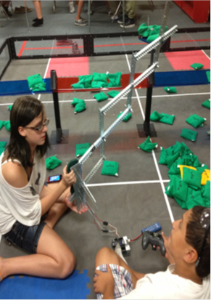
Establish Project Oriented Education
  Students Take Ownership In Their Robots
  Competition Aspect Enhances Learning
  Diverse Demographic Appeal
  Engages Students At All Levels

Slide 4
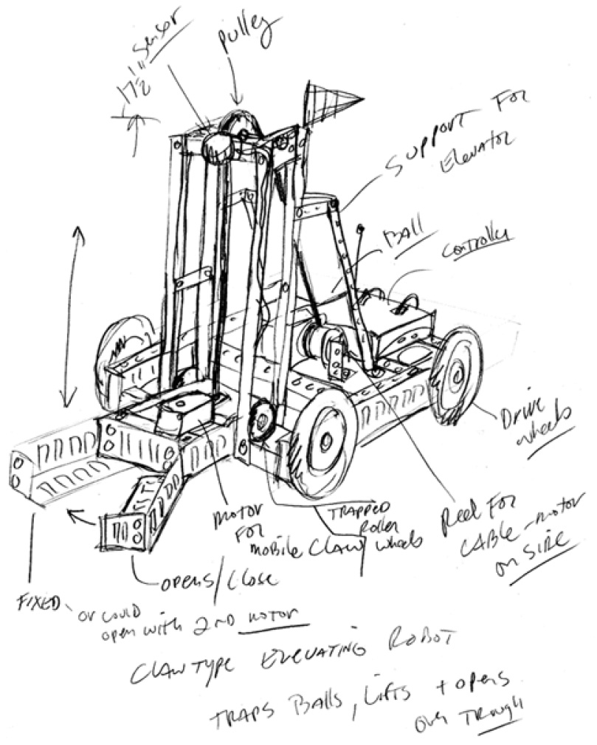
Apply Knowledge Gained in Core Classes
    Math
    Science
    Language Arts
    Technology
    Oral Communication

Slide 5
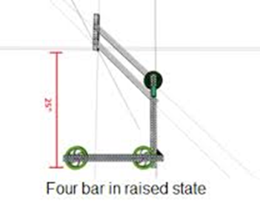
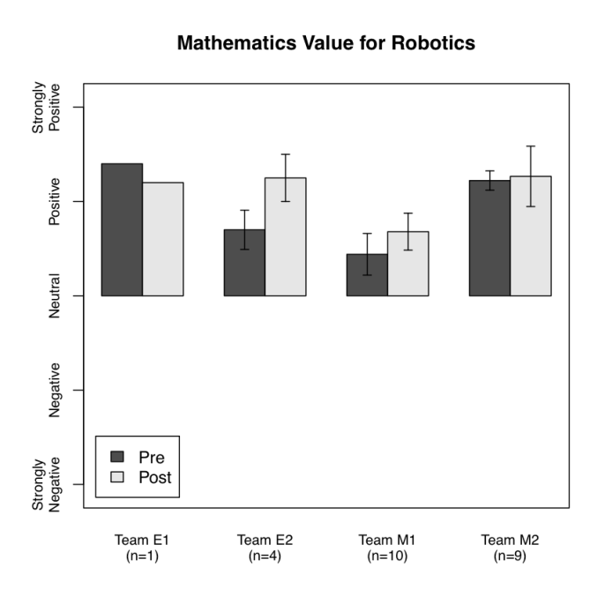
Math
Applied Geometry
  Circumference Formula
  Radius
  Pythagorean Theorem
  Match Scoring
    Fibonacci Sequence

Slide 6
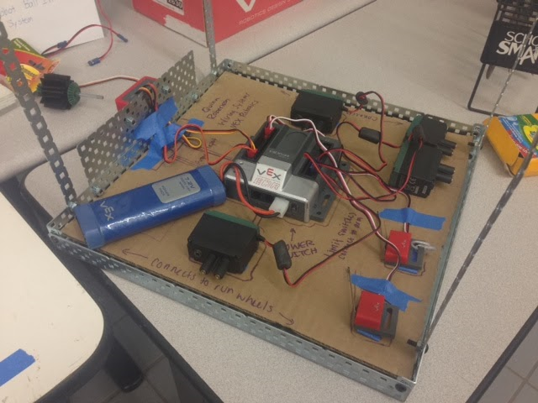
Science
Speed
Acceleration
Force
Torque
Amps

Slide 7


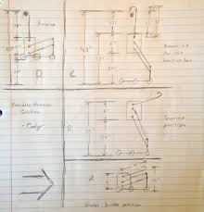
Language Arts
Engineering Notebook
Online Challenge(s)
Scouting Reports
Blogs
Facebook Page

Slide 8
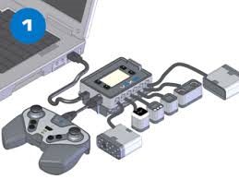
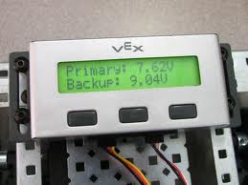
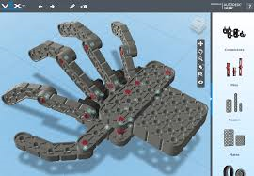
Technology
Computer Programming
CAD
Electrical Wiring
Web Page Design

Slide 9
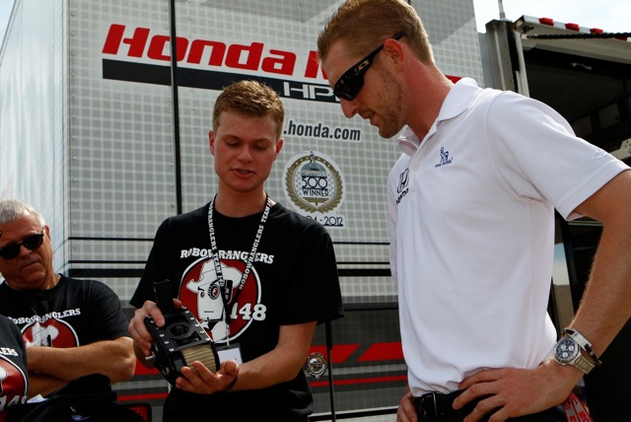
Oral Communication
Effectively Communicate Design Ideas to their Team Members
Effectively Communicate Design Ideas to Judges
Determine Strategy with Alliance Partners
Sell Robot to Potential Alliance Partners in the Elimination Rounds

Slide 10
Two Program Options:
Classroom Curriculum
Competition Teams

Slide 11
Getting Started in the Classroom

Slide 12





Choose a Platform
Vex
Lego
B.E.S.T . (Boosting Engineering Science and Technology)
F.I.R.S.T. (For Inspiration and Recognition of Science and Technology)

Slide 13

Criteria to Use
  Age appropriate at each grade level
  Parts availability
  Technical support
  Competition component
  Number of local competitions
  Cost
  GISD uses VEX

Slide 14
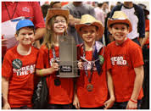
Elementary Robotics
Grades 5 & 6

Slide 15

Free Curriculum found at:
http://www.vexrobotics.com/vexiq/education/iq-curriculum
12 Flexible Units That can Be used in:
    Sequence
    In chunks
    Standalone Lessons

Slide 16
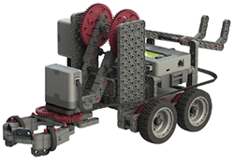
Examples of
Available Units
It’s Your Future
  Learn about STEM, Engineering, and Robotics
  Let’s Get Started
    Learn about the Curriculum, the VEX IQ Platform Kit, the Controller, and the Robot Brain
    Your First Robot
    Build and Test Clawbot IQ

Slide 17
Examples (cont.)
Simple Machines and Motion
  Explore the World of Levers, Pulleys, Pendulums, and More
  Key Concepts
    Explore and apply the science and math that engineers use
      Smart Machines
        Learn How Sensors Work and the Basics of Programming

Slide 18
Middle School
Pre-STEM Academy
Robotics

Slide 19
Pre-STEM Courses
Intro to STEM (Programing/Engineering) (1 semester)
  Students will learn about engineering disciplines and technology. They will utilize the Vex IQ System along with other hands on STEM projects. They will also learn to program using Code.org through the Hour of Code program which can be applied to their VEX IQ robots. They will complete a STEM research project around different engineering professions.

Slide 20
Pre-STEM Courses
Developmental Robotics (1 Semester)
  This class will utilize the VEX IQ Robotics System and curriculum to learn the principles of robotics. Students will complete a robot for an in-district exhibition near the end of each semester for the public. They will also complete a STEM research project.

Slide 21
Pre-STEM Courses
Advanced Robotics non-competition (Yearlong)
  Prerequisite: Previous Robotics Experience
  This class builds on the Developmental Robotics Class. It utilizes the VEX Robotics System and students would complete a VEX Robot to compete in an in-district exhibition at the end of the year. This class allows students that do not make the competition team, but want to continue their district robotics experience, to increase their robotics knowledge. This course will better prepare students to continue in STEM classes in high school and allow them an additional avenue for preparation to tryout for the high school robotics/technical programs.

Slide 22
Competition Robotics
VEX IQ
VEX Robotics Competition (VRC)
F.I.R.S.T. (FRC)

Slide 23
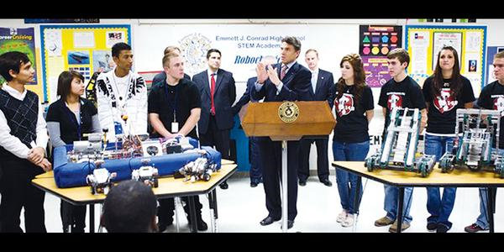
Why Have Competition Teams?
Establish a Set of Core Values That Guides Everything Students/Adults Do
Learn About Areas Rich with Career Opportunities
The excitement of Competition makes Competition Robotics the Ultimate “Sport for the Mind”
Compliments Our Community Workforce

Slide 24
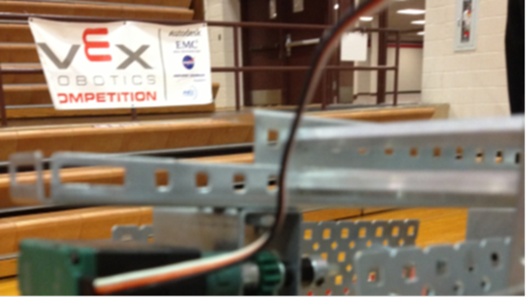
How to Start a Competition Robotics Team
Do’s and Dont’s

Slide 25
Initial Steps for a Successful Program
Prepare a Plan
    Cost Estimate
    Student Target Demographics
    Coaching Requirements
Gain Support of Your Administration
Choose a Platform That Fits the Budget

Slide 26

Elementary School

Slide 27
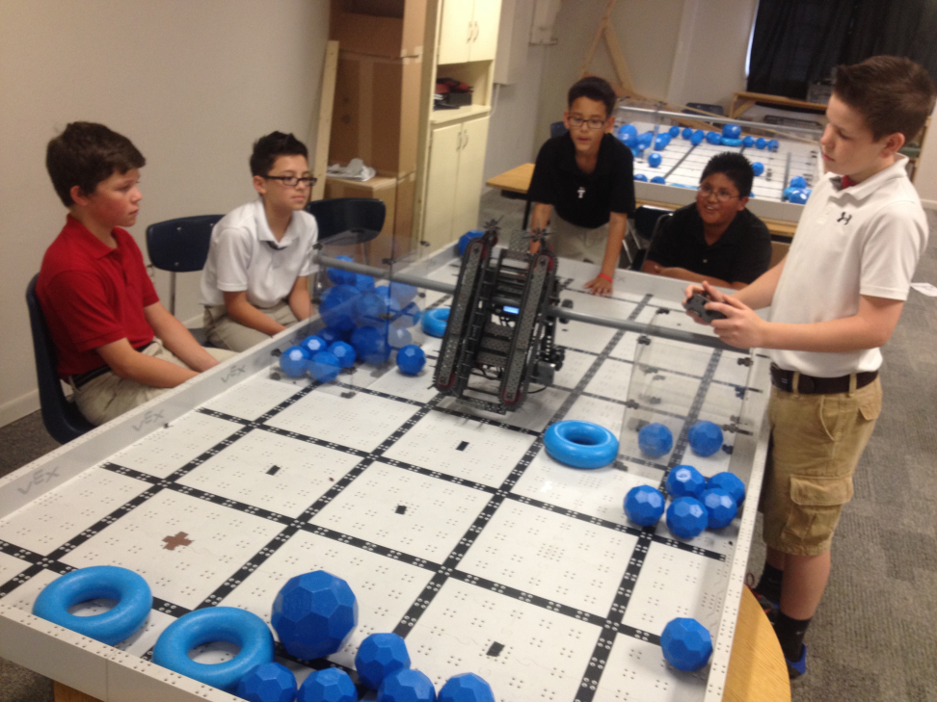
Where it Starts
Starts In Fifth Grade At All Elementary Campuses
Continues In Sixth Grade With A VEX IQ Team
For More Information Go To:
http://www.roboticseducation.org/vex-iq-challenge/viq-teams

Slide 28

Middle School

Slide 29
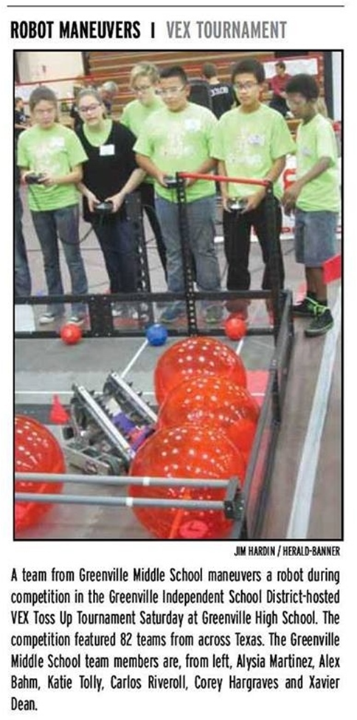
How To Start & Organize A Vex Robotics Team
Example Topics
    Getting Started
    Assign Team Roles
    Develop A Team Identity
    Assemble An Adequate Toolkit
http://www.roboticseducation.org/documents/2013/06/how-to-start-a-team.pdf

Slide 30
101 Things You Should Know Before Your First VEX Tournament
www.roboticseducation.org/documents/2013/06/101-things.pdf
Examples:
The robot should be no more complicated than necessary. "Keep it simple, make it fun, keep it safe."
Always expect the unexpected.
Yes, kids really do cry when their robot loses. Adults sometimes do, too.

Slide 31

Gig-A-Bots
Competition Robotics (Yearlong)
  Student teams design, program, and build VEX competition quality robots for use at VEX Robotics Tournaments at the local, state, national and world level.

Slide 32


High School

Slide 33


Robowranglers
The “Robowranglers” are an original F. I. R. S. T. team established in 1992
They are 2 time World Champions – 1992 and 2008
For more information please go to their website;
www.robowranglers.com

Slide 34

Iron Cowboys
Evolving since the first year of VEX in 2005
One Time National Champion – 2005
Program is growing exponentially due to the popularity of the Middle School VEX Program
Hiring a dedicated VEX Assistant Coach for the upcoming school year

Slide 35
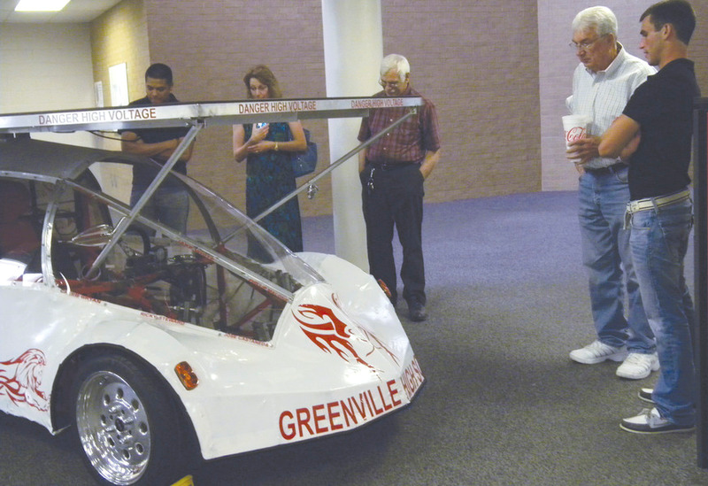
Solar Car
This program builds a compact size car powered by solar panels
Their competition is held in July
Last year, they drove the car from Dallas to Los Angles
This year , they will compete a
Texas Motor Speedway before
driving to Austin

Slide 36
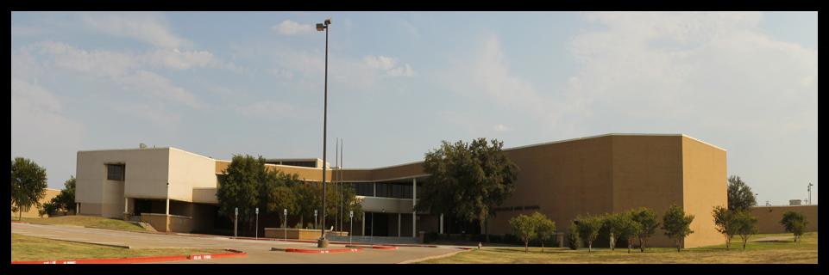
Establishing a New Technology Academy
New Solar Car Lab
Café for Culinary Arts
Agricultural Science
Automotive Body and Repair
Automotive Technology
Building Trades
Electromechanical Engineering
Health Services
Information Technology
Welding

Slide 37





Additional Information
Greenville ISD
RECF
VEX IQ
VEX
LEGO
F. I. R. S. T.
B. E. S. T.

Slide 38
Greenville ISD
We are frontrunners. We are dynamic. We are red.
Elementary and Middle School Robotics
Johnny Tharp – tharpjr@greenvilleisd.com (903) 408-4432
Elementary School Robotics
James Hardaway – hardawayj@greenvilleisd.com (903) 408-4716
Middle School Robotics
Orion Casper – caspero@greenvilleisd.com (903) 453-3250
High School Robotics
Adrienne Emerson – emersona@greenvilleisd.com (903) 453-3741/3742
High School Solar Car
Joel Pitts – pittsj@greenvilleisd.com (903) 453-3714

Slide 39
VEX & VEX IQ
VEX
Parts and Supplies (VEX & VEX IQ)
http://www.vexrobotics.com
Tournament & Team Registration (RECF)
http://www.robotevents.com
General Information (RECF)
http://www.roboticseducation.org

Slide 40
F.I.R.S.T. & B.E.S.T.
F.I.R.S.T.
General Information, Teams & Events
http://www.usfirst.org
B.E.S.T.
http://best.eng.auburn.edu

