Slide 1
McKinney-Vento 101:
Educating Homeless
Children and Youth
LOCATION: Education Service Center Region ##
Room Location
DATE: Month Day, Year
TIME: Start time a.m. – End time p.m.
PRESENTER: Homeless Liaison, Consultant, Region ##

Slide 2
WELCOME!

Slide 3




Education for Homeless Children and Youths (McKinney-Vento) Program in Texas
Welcome
TEXAS HOMELESS
EDUCATION OFFICE

Slide 4
Welcome
Contact info for TEA
Kelly M. Kravitz, MPSA
Foster Care Education & Policy and
McKinney-Vento Homeless, State Coordinator
Division of Federal & State Education Policy
Texas Education Agency
1701 N. Congress Ave.
Austin, Texas 78701-1494
Kelly.Kravitz@tea.texas.gov
(512) 463-9235 office

Slide 5
Welcome
Contact info for Region 10
David Ray
Program Coordinator for Homeless and
Foster Care Education
Region 10 Education Service Center
904 Abrams Road
Richardson TX 75081
David.Ray@region10.org
(512) 463-9235 office

Slide 6
Welcome
Contact info for THEO
Jeanne Stamp, LCSW, LMFT, LCDC, ACSW
Project Director
The Texas Homeless Education Office
The Charles A Dana Center
The University of Texas at Austin
1616 Guadalupe St, Suite 3.206
Austin, Texas 78701
jeannestamp@austin.utexas.edu
512-475-6898 office
800-446-3142 in Texas

Slide 7
Welcome
In order to comply with the ESSA rules regarding the training of homeless education personnel across the state, please register for this training in addition to any registration or sign-in you have done already today.
Use any electronic device to log in to
http://www.region10.org/mvhpd

Slide 8
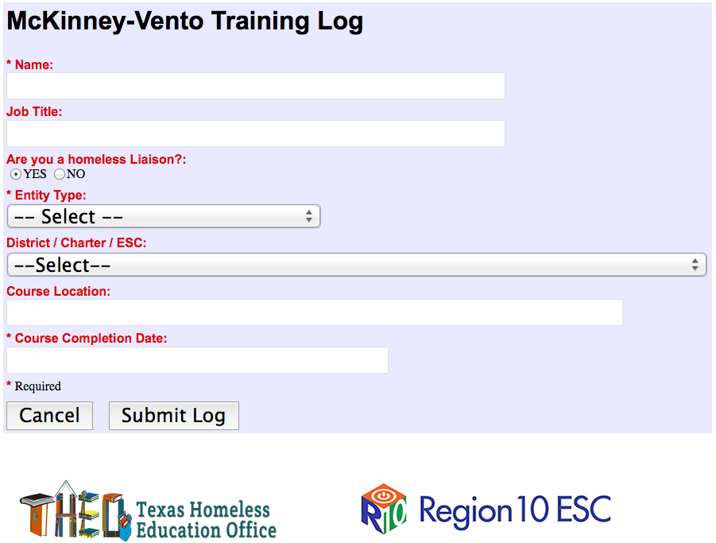
Welcome
http://www.region10.org/mvhpd
The following screen will display:
Pull-down menu: LEA non-subgrantee, LEA subgrantee, or select another type
Pull-down menu: Select the name of your LEA
Enter the name of the ESC or other location where the training is taking place
Use the pop-up calendar to pick today’s date

Slide 9
Welcome
Training Overview
Part I – Identification and Enrollment — 90 minutes
Awareness
M-V Act Overview
Liaison Duties
Definition of Homelessness (Eligibility Determination)
Identification of Students/
Unaccompanied Youth
Outreach
School Selection and Enrollment
  School of Origin
  School Records
  Guardianship
  Immunizations

Slide 10
Welcome
Training Overview
Part II – Support Services — 45 minutes
Child Nutrition
Transportation
Attendance
TEC 33.906
Special Education
Resolution of Disputes
Academic Success
Higher Education/FAFSA
Website Resources

Slide 11
Welcome
Training Overview
Part III – Collaboration — 30 minutes
FERPA
Title I / Title I, Part A
Foster Care
Housing Programs
Community Collaborations
Statewide Homeless Youth Report (from HB679)
TEXSHEP Subgrants
Notes:
Remove white frame.

Slide 12
Who are the homeless children and youth the McKinney-Vento Act seeks to assist?
Part I
Getting Things Started
HOMELESS =
lacks a
        fixed…
        regular… and
        adequate
nighttime residence
Notes:
Add statement to script– any ONE of these conditions make a student eligible.

Slide 13
Part I
Part I – Identification and Enrollment
Awareness
M-V Act Overview
Liaison Duties
Definition of Homelessness
Unaccompanied Youth
Determining Eligibility
  Identification
  Outreach
  PEIMS
School Selection and Enrollment
  School of Origin
  School Records
  Guardianship
  Immunizations

Slide 14
How many school-age children experience homelessness in the U.S.?
Part I
Awareness
1,129,791
USDE CSPR; SY 2011-12
1,216,888
USDE CSPR; SY 2012-13
1,298,450*
USDE CSPR; SY 2013-14
*3.6% of total student population

Slide 15
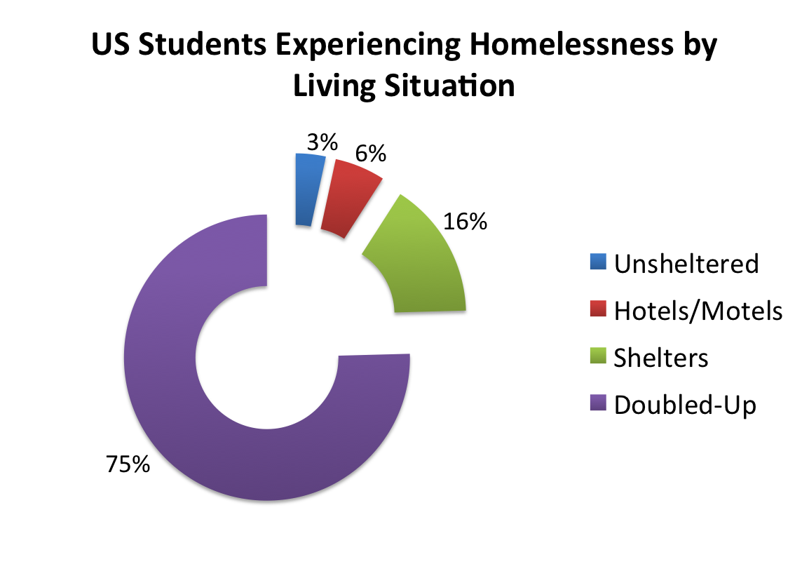
Primary Nighttime Residence at Time of Enrollment
Part I
Awareness
1,298,450
= Total
United
States Students Identified
Notes:
Fix number.

Slide 16

Texas Student Data (TEA): 2014-15
Part I
Awareness
Total student enrollment in public schools: 5,232,065
Total students economically disadvantaged: 3,068,820
Economically disadvantaged student rate: 58.8%
Total homeless students enrolled: 113,063

Slide 17
How many children and youth experience homelessness?
Part I
Awareness
The Urban Institute estimates that approximately 10% of all children experiencing poverty will experience homelessness in a year.
According to the 2010 TEXAS census data –
1,584,000 children lived below poverty level in TX –
10% would be 158,400
Notes:
Change the numbers to match website.

Slide 18
How many children and youth experience homelessness in Texas?
Part I
Awareness
53,200
2007-2008
80,940
2008-2009
76,095
2009-2010
Texas homeless
students served
by academic
year as reported
by the Texas
Education
Agency . . .
85,155
2010-2011
113,063
94,624
2011-2012
2014 - 2015
101,088 *
2012-2013
111,759
2013-2014
* First year of PEIMS
Notes:
Change numbers for 14-15. Fix animations. A. Add a new slide with districts that have not identified, etc., by ESC region – put excel sheet up on ToT website with actual masked numbers for presenters to use. How do we help districts realize that they have homeless students if they aren’t reporting any? Add slide aoubt what people think of when they think about homelessness.

Slide 19
Primary Nighttime Residence at Time of Enrollment
Part I
Awareness
113,063
= Texas
Total
Students Identified

Slide 20
Do older youth become homeless?
Part I
Awareness
Over 1.7 million youth run away from home each year
  High rates of abuse, neglect, parental substance abuse, family dysfunction – often unreported
  Runaways are most likely homeless
Notes:
Change sequence of legend to match the PEIMS codes.

Slide 21
Do younger children become homeless?
Part I
Awareness
51% of all children in HUD-funded homeless shelters are under the age of 6
The age at which a person is most likely to stay in a homeless shelter in the United States is infancy (under age 1)
Nearly 50,000 homeless children ages 3-5 were enrolled in public PreK programs in 2013-2014

Slide 22
Contributing Factors to Homelessness
Part I
Awareness
Lack of Affordable Housing
Lack or loss of economic support networks
Lack or loss of social support networks
Domestic violence
Alcohol dependency
Drug dependency
Family disintegration
Lack of education
Unemployment
Lack of job skills
Underemployment
Serious illness
Natural disaster
Mental illness

Slide 23
Challenges of Living in a Homeless Situation
Part I
Awareness
Loss of Control and Independence
Lack or loss of parental control/authority
Lack or loss of privacy
Mealtimes/decisions
Child play
“Lock out” times in shelters / access to living quarters
Child care
Transportation
Other challenges…
Notes:
Add health-related issues to the list. Add safety concerns Change child play to a different name, combine with child care.

Slide 24
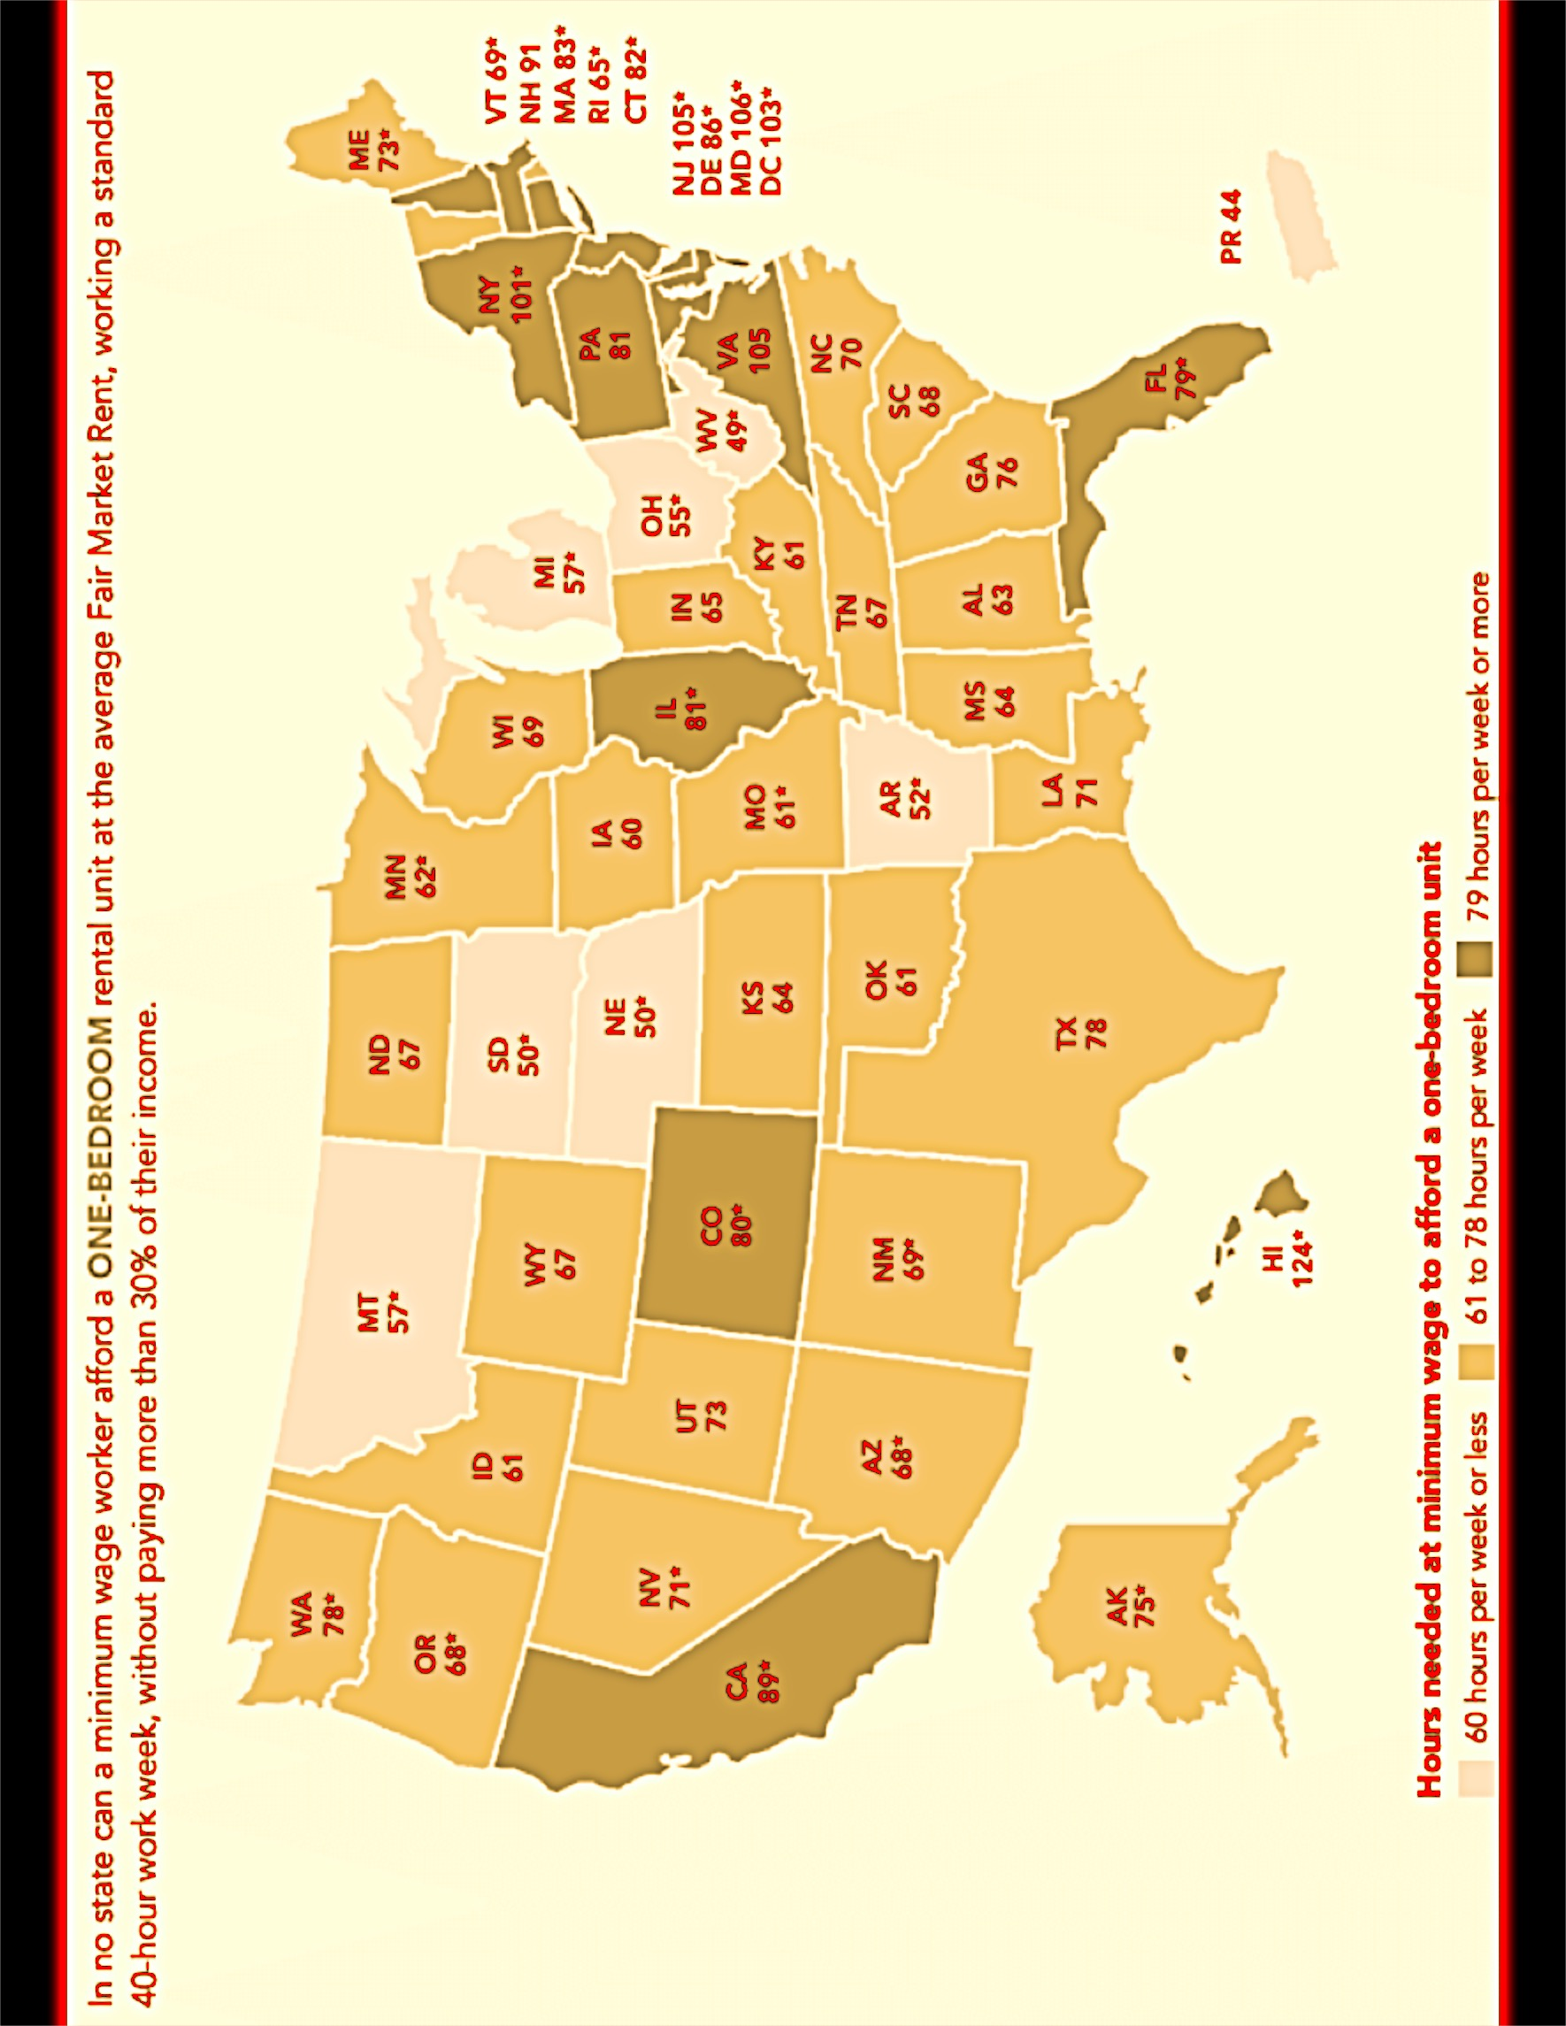
Part I
Awareness
Notes:
Move 29, 30, 31 to after slide 23, before trauma

Slide 25
Demographics for local ESC Region or ISD
Part I
Awareness
Population:
Population Growth:
Households:
Median Age:
Median Income:
Unemployment Rate:
Median Home Value:
Poverty Rate
Child Poverty Rate
Rental Rates
1 BR= $ 2 BR= $
TX avg = $826 =
$14.97/hr. x 42 x 52 =
1.1 wage earners
or 2.2 min wage earners
Children
ISD student population:
In Poverty:
Homeless Identified:
Sources to use: www.city-data.com/housing/houses.html
Out of Reach, National Low Income Housing Coalition - www.nlihc.org
Notes:
Confirm data – 2BR? One BR?

Slide 26
Children living in homeless situation experience the trauma of loss:
Part I
Awareness
home / room / neighborhood /
family members / school / community / possessions / security / safety /
self esteem / predictable routines
Notes:
Add pets to list.

Slide 27
A program, organization, or system that is trauma-informed:
Part I
Awareness
Realizes the widespread impact of trauma and understands potential paths for recovery
Recognizes the signs and symptoms of trauma in clients, families, staff, and others involved with the system
Responds by fully integrating knowledge about trauma into policies, procedures, and practices
Seeks to actively resist re-traumatization
A trauma-informed approach can be implemented in any type of organization and is distinct from trauma-specific interventions or treatments that are designed specifically to address the consequences of trauma and to facilitate healing.

Slide 28
Six Key Principles of a Trauma-Informed Approach:
Part I
Awareness
A trauma-informed approach adherences to six key principles rather than a prescribed set of practices or procedures.
• Safety
• Trustworthiness and Transparency
• Peer support
• Collaboration and mutuality
• Empowerment, voice and choice
• Cultural, Historical, and Gender Issues
It is critical to promote the linkage to recovery and resilience for those individuals and families impacted by trauma.
Notes:
Fix typo – “adherences”

Slide 29
Trauma-specific intervention programs generally recognize the following:
Part I
Awareness
• The survivor's need to be respected, informed, connected, and hopeful regarding their own recovery
• The interrelation between trauma and symptoms of trauma such as substance abuse, eating disorders, depression, and anxiety
• The need to work in a collaborative way with survivors, family and friends of the survivor, and other human services agencies in a manner that will empower survivors and consumers
Resources:
Substance Abuse and Mental Health Services Administration (SAMSHA) – www.samhsa.gov
Trauma Sensitive Schools - https://traumasensitiveschools.org/

Slide 30
Video Segment #1
Region 10 video on Trauma
2:00 minutes
Part I
Awareness

Slide 31
Cycle of Homelessness
Part I
Awareness
Start
Complications/Personal Crisis
•Modest Resources
•Underemployment
•Fixed Income
•Family Break-up
•Job Loss
•Health Problem
•Earthquake
•Domestic Violence
•AIDS
•Substance Abuse
•Fire
Conditions
Result
•Lack of Affordable Housing
•Lack of Jobs and Insufficient Incomes
•Lack of Support Services
•Move Out/
Lose Home/Evicted
Now Endangered
Outcome
•Job
•Family Life
•Mental/Physical Health
•Safety
•Homelessness
Source: Mary Ann Weinacht, Ed.D., Assoc. Professor & Mary Nan Aldridge, Ph.D., Professor, Sul Ross State University

Slide 32
Part I
Awareness
Children living in homeless situations may perform two to three years below grade level in school.
For many children, every move costs them as much as 4-6 months of academic progress.
Casey Family Programs

Slide 33
Schools were not designed to serve homeless students!
Part I
Awareness
We have to adjust our schools to meet the situations in which these children and youth are living.

Slide 34
Part I
Part I – Identification and Enrollment
Awareness
M-V Act Overview
Liaison Duties
Definition of Homelessness
Unaccompanied Youth
Determining Eligibility
  Identification
  Outreach
  PEIMS
School Selection and Enrollment
  School of Origin
  School Records
  Guardianship
  Immunizations

Slide 35
McKinney-Vento Homeless Education Assistance Improvements Act
Part I
M-V Act Overview
Originally passed in 1987
Became part of No Child Left Behind in 2000
Reauthorized in 2015 by the Every Student Succeeds Act (ESSA)
Works hand-in-hand with Title IA and other federal education programs
$85 million authorized funding to SEAs
    SEAs award competitive subgrants to LEAs
    Largest percentage increase of all federal education programs

Slide 36
Main themes:
Part I
M-V Act Overview
  SEA/State Coordinator roles
  School access: Identification and Enrollment
  School stability
  Support for academic success
  Child-centered, best interest decision making
  Case-by-case determinations
  Critical role of the homeless liaison

Slide 37
State Coordinators:
Part I
M-V Act Overview
States must designate State Coordinators
who can sufficiently carry out their duties
State coordinators must:
      Conduct monitoring of local educational agencies (LEAs)
      Publish annually updated list of liaisons on State Education Agency (SEA) website
      Respond to inquiries from homeless parents and unaccompanied youth

Slide 38
State Coordinators must:
Part I
M-V Act Overview
  Post the number of homeless children and youth on the SEA website annually
  Collect and submit data that the McKinney-Vento Act requires the Secretary to submit to Congress

Slide 39
State Coordinators must:
Part I
M-V Act Overview
Develop and implement professional development programs for liaisons and LEA personnel to improve their identification of homeless children and youth and heighten their awareness of, and capacity to respond to, specific needs in the education of homeless children and youth
Such training must include information on certain specified federal definitions of homelessness

Slide 40
State Coordinators must coordinate and collaborate with:
Part I
M-V Act Overview
School personnel and educators, including administrators and teachers, counselors/social workers, and program personnel (e.g., special education, child development and preschool, athletics and other extra-curricular activities)
Providers of services to homeless children and youths and their families, including services of public and private child welfare and social services agencies, law enforcement agencies, juvenile and family courts, agencies providing mental health services, domestic violence agencies, child care providers, runaway and homeless youth centers, and providers of services and programs funded under the Runaway and Homeless Youth Act (42 U.S.C. 5701 et seq.)

Slide 41
State Coordinators must coordinate and collaborate with: (continued)
Part I
M-V Act Overview
Providers of emergency, transitional, and permanent housing to homeless children and youths, and their families, including public housing agencies, shelter operators, operators of transitional housing facilities, and providers of transitional living programs for homeless youths.

Slide 42
The key to McKinney-Vento Act Implementation:
Part I
M-V Act Overview
  Every school district must designate a liaison who is in charge of implementing the McKinney-Vento Act
    Ensures identification, enrollment, transportation, services, dispute resolution, and awareness.
    Works in coordination with all the schools in the district, as well as the community.

Slide 43
Part I
Part I – Identification and Enrollment
Awareness
M-V Act Overview
Liaison Duties
Definition of Homelessness
Unaccompanied Youth
Determining Eligibility
  Identification
  Outreach
  PEIMS
School Selection and Enrollment
  School of Origin
  School Records
  Guardianship
  Immunizations

Slide 44
Part I
Liaison Duties
LEA homeless liaisons must ensure that:
School personnel providing McKinney-Vento services receive professional development and other support
Children, youth and families have access to and receive educational services for which they are eligible, including Head Start, early intervention (IDEA Part C) and other preschool programs
Children, youth and families receive referrals to health care, dental, mental health, substance abuse, housing and other services (i.e., SNAP, TANF)

Slide 45
Part I
Liaison Duties
Liaisons must ensure that (continued):
Disputes are resolved and assistance to access transportation is provided.
Youth are enrolled in school and that procedures are implemented to identify and remove barriers that prevent them from receiving credit for full or partial coursework satisfactorily completed at a prior school, in accordance with state, local, and school policies. (TX-SB1494)

Slide 46
Part I
Liaison Duties
Liaisons must ensure that (continued):
Liaisons themselves must participate in professional development and technical assistance as determined appropriate by the State Coordinator. 11432(g)(1)(F)(ii)

Slide 47
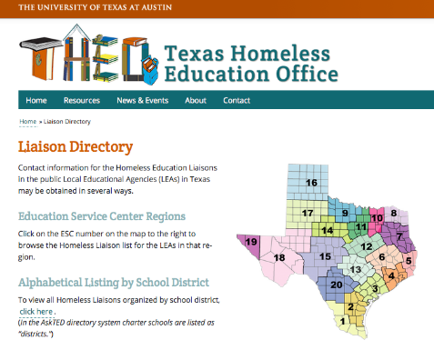
Part I
Liaison Duties

Slide 48
Part I
Part I – Identification and Enrollment
Awareness
M-V Act Overview
Liaison Duties
Definition of Homelessness
Unaccompanied Youth
Determining Eligibility
  Identification
  Outreach
  PEIMS
School Selection and Enrollment
  School of Origin
  School Records
  Guardianship
  Immunizations

Slide 49
Part I
Definition of Homelessness
McKinney-Vento-eligible
children and youth lack a
fixed …
regular … and
adequate …
nighttime residence.

Slide 50
Part I
Definition of Homelessness
fixed ….
Securely placed or fastened
A fixed residence is one that is stationary, permanent, and not subject to change or fluctuation
“Inhabitant:” One who, although he may not be a citizen, dwells or resides in a place permanently or has a fixed residence therein, as distinguished from an occasional lodger or visitor
“Domicile:” The place where a person has his true fixed permanent home and principal establishment, and to which place he has, whenever he is absent, the intention of returning, and from which he has no present intention of moving

Slide 51
Part I
Definition of Homelessness
regular ….
Normal, standard
Constituted, conducted, or done in conformity with established or prescribed usages, rules, or discipline
Recurring, attending, or functioning at fixed or uniform intervals
Consistent
Used on a regular basis (i.e., nightly)
Habitual: by habit; constant; customary, accustomed, usual; common; ordinary; regular; familiar

Slide 52
Part I
Definition of Homelessness
adequate ….
Sufficient for a specific requirement
Lawfully and reasonably sufficient
Fully sufficient; equal to what is required; lawfully and reasonably sufficient
Sufficient for meeting both the physical and psychological needs typically met in home environments

Slide 53
Why is the definition so broad?
Part I
Definition of Homelessness
Shelters are often full; shelters may turn families away, or put families on waiting lists
Shelters do not exist in many suburban and rural areas
Eligibility conditions of shelters often exclude families with boys over the age of 12
Shelters often have 30, 60, or 90 day time limits

Slide 54
Why is the definition so broad? (continued)
Part I
Definition of Homelessness
Motels may not be available, may be too expensive, or may be run-down and inadequate
Families may turn to friends or family after initial eviction, living in over-crowded, temporary, and sometimes unsafe environments
Families may be unaware of alternatives, fleeing in crisis

Slide 55
Video Segment #2
Hear Us Video –
Brandy, Kenny, and the Kids
Minute xx:xx – xx:xx
Part I
Definition of Homelessness

Slide 56
Doubled-Up Situations
Part I
Definition of Homelessness
Children who lack a fixed, regular, and adequate nighttime residence include those:
  Sharing the housing of others due to loss of housing, economic hardship, or similar reason.
        Where would you go if you couldn’t stay here?
        What led you to move in to this situation?
      Why did the family move in together?
      How permanent is the arrangement meant to be?
      Is it fixed, regular, and adequate?

Slide 57
Hotels and Motels
Part I
Definition of Homelessness
Children who lack a fixed, regular, and adequate nighttime residence include those:
  Living in motels, hotels, trailer parks, camping grounds due to the lack of adequate alternative accommodations.

Slide 58
Shelters
Part I
Definition of Homelessness
Children who lack a fixed, regular, and adequate nighttime residence include those:
  Living in emergency or transitional shelters.

Slide 59
Public Spaces
Part I
Definition of Homelessness
Children who lack a fixed, regular, and adequate nighttime residence include those:
  Living in a public or private place not designed for humans to live.

Slide 60
“Substandard” or Inadequate Housing
Part I
Definition of Homelessness
Children who lack a fixed, regular, and adequate nighttime residence include those:
  Living in housing that is not able to perform its intended purpose.
  See the definition of “adequate” shared earlier.

Slide 61
“Substandard” or Inadequate Housing (continued)
Part I
Definition of Homelessness
  Communities vary - evaluate housing according to local standards/norms
  Sample considerations:
        Health and safety concerns
        Number of occupants per square foot
        Age of occupants
        State and local building codes
  Collaborate with local housing agencies to establish guidelines that incorporate state and local legal requirements and community standards
  (i.e., Section 8 criteria)

Slide 62
Migratory/Migrant Students
Part I
Definition of Homelessness
Children who lack a fixed, regular, and adequate nighttime residence include those:
  Who are migratory or are in migrant student programs AND who lack a fixed, regular, and adequate nighttime residence.
  Migrant students are NOT homeless by virtue of their migrant status.

Slide 63
Military Dependents
Part I
Definition of Homelessness
Children who lack a fixed, regular, and adequate nighttime residence include those:
  Who are dependents of military parents or guardians AND lack a fixed, regular, and adequate nighttime residence as a result of a military deployment or similar reason.

Slide 64
“Substitute Care” and Foster Care
Part I
Definition of Homelessness
  Children who are wards of the state ARE NOT M-V eligible, regardless of their living situation.
  Non-Regulatory Guidance: definition of “child in foster care”
  “24-hour substitute care for children placed away from their parents or guardians and for whom the child welfare agency has placement and care responsibility. This includes, but is not limited to, placements in foster family homes, foster homes of relatives, group homes, emergency shelters, residential facilities, child care institutions, and preadoptive homes. A child is in foster care in accordance with this definition regardless of whether the foster care facility is licensed and payments are made by the State, Tribal or local agency for the care of the child….” (Question #1)

Slide 65
“Substitute Care” and Foster Care (continued)
Part I
Definition of Homelessness
  Any of the following documentation would indicate that a student is not eligible for M-V services:
  A copy of a court order designating that a student is in Texas Department of Family and Protective Services (DFPS) Temporary Managing Conservatorship (TMC) or Permanent Managing Conservatorship (PMC)
  A DFPS verification of prekindergarten eligibility letter
  Court/and or Legal paperwork stating another party outside of Texas DFPS is the legally authorized representative or the custodial parent

Slide 66
“Substitute Care” and Foster Care (continued)
Part I
Definition of Homelessness
  All forms in the 2085 series:
    Foster Care/Residential Care - 2085 FC
    Kinship or Other Non-Foster Caregiver - 2085 KO
    Verified Kinship Foster Caregiver - 2085 KF
    Legal Risk - 2085 LR
    Home and Community-based Services (HCS) - 2085 HCS
    Supervised Independent Living - 2085 SIL
    Designation of Education Decision-Maker - 2085 E3

Slide 67
“Substitute Care” and Foster Care (continued)
Part I
Definition of Homelessness
  Any of the following documentation would indicate that a student is most likely not eligible for M-V services (must be further investigated):
Placement Authorization forms from child placing agencies
Letters from child placing agencies
Documents from another state’s child welfare system
Documentation that a student is in conservatorship under another party other than Texas DFPS (e.g. Unaccompanied Refugee Minors)

Slide 68
“Substitute Care” and Foster Care (continued)
Part I
Definition of Homelessness
  Any of the following documentation would indicate that a student is eligible for M-V services:
State of Texas Authorization Agreement for Nonparent Relative or Voluntary Caregiver
Agreement for a Parental Child Safety Placement - DFPS 2298
Home and Community-based Services (HCS), Department of Aging and Disability Services - Form 8665

Slide 69
Undocumented Immigrants
Part I
Definition of Homelessness
Under Supreme Court decision Plyler v. Doe, undocumented students entering the US from Mexico, Central America, and other countries have the right to enroll in and attend public schools in the US, just as any citizen would.

Slide 70
Unaccompanied Immigrant/Alien Children (UIC)
Part I
Definition of Homelessness
While children are in detention and temporary shelter, the Department of Health and Human Services (DHHS) has the legal obligation to meet their basic needs, including shelter, food, health care and education.

Slide 71
Unaccompanied Immigrant Children (continued)
Part I
Definition of Homelessness
UIC exist in a complex legal limbo that affects their housing status
From their initial apprehension to their transfer to temporary DHHS custody awaiting longer-term placement, they are essentially in federal custody
Generally, children in this status are not eligible for McKinney-Vento services, because they would not be considered “homeless
Education services are provided on-site
Children’s average stay in temporary placement is 35 days until they are moved to a longer-term placement in the community

Slide 72
Unaccompanied Immigrant Children (continued)
Part I
Definition of Homelessness
Once children are placed in the community, they are more likely to be eligible for McKinney-Vento services
Once children have been placed in longer-term accommodations—whether in a group home, shelter, foster family or with another individual—their education becomes the responsibility of the local school district
When a child presents for enrollment at a school, his/her living situation must be assessed and a determination made about their homeless status just as for any other student

Slide 73
Part I
Part I – Identification and Enrollment
Awareness
M-V Act Overview
Liaison Duties
Definition of Homelessness
Unaccompanied Youth
Determining Eligibility
  Identification
  Outreach
  PEIMS
School Selection and Enrollment
  School of Origin
  School Records
  Guardianship
  Immunizations

Slide 74
Video Segment #3
Region 10 video on Unaccompanied Youth
2:00 minutes
Part I
Determining Eligibility

Slide 75
Part I
Unaccompanied Youth
  The McKinney-Vento Act defines an “unaccompanied youth” as a youth that is not in the physical custody of a parent or guardian.
    “Guardian” is a legal designation representing the person who has legal custody of a student; this designation can only be granted by a judge in a court of law
    “Guardian” does not include those persons who have signed an “educational affidavit” or notarized document pertaining to a student’s care
    “Guardian” does not include those persons who have been given a “power of attorney” or notarized letter to care for a student by his/her parent or legal guardian

Slide 76
Part I
Unaccompanied Youth
  An unaccompanied youth’s living situation must meet the M-V Act’s definition of homeless in order to qualify for M-V services and to be considered a HOMELESS unaccompanied youth…
A youth may be eligible regardless of whether he/she was asked to leave the home or “chose” to leave their home
There is often “more than meets the eye” in a youth’s home life situation
… the circumstances/motivation around a youth leaving their home are inconsequential; only the youth’s current living situation is evaluated.

Slide 77
Part I
Unaccompanied Youth
  Many youth become separated from parents due to lack of space in living situations or shelter policies
  Many flee abuse: 20-50% sexual; 40-60% physical
  Many flee family dysfunction: Over 2/3 Hotline callers report at least one parent abuses drugs or alcohol
  Roughly 33-40% homeless youth identify as LGBTQ (compared to 3–5% of the overall population)
  10% of currently homeless female teens are pregnant

Slide 78
Unaccompanied homeless youth are often not identified due to:
Part I
Unaccompanied Youth
  Youth is embarrassed to tell
  Youth is afraid to tell – afraid of authority, CPS, Police
  Youth does not know their living situation meets the M-Vento definition of homeless
  Youth do not know their rights
  Youth do not have trusted adult relationships
  Many youth must work to support themselves and to contribute to the household in which they are staying
  Unaccompanied homeless youth are particularly at-risk for trafficking, sexual/physical abuse and exploitation

Slide 79
Liability and reporting
Part I
Unaccompanied Youth
Liability is based upon negligence
Following federal law and providing appropriate services are evidence of reasonable care, and written policy and procedures can help shield the school from liability
(Violating federal law and denying services are evidence of negligence.)
MV requires eliminating barriers to enrollment and retention in school.
  School is the safest and best place for youth.

Slide 80
Liability and reporting
Part I
Unaccompanied Youth
Educators are mandated to report suspected abuse and/or neglect on a case-by-case basis.
  Homelessness alone is not abuse/neglect.

Slide 81
Liability and reporting
Part I
Unaccompanied Youth
  Schools are mandatory reporters of suspected abuse; schools are NOT legally required to report runaways.
      Local policy may require reporting
      Runaways are unaccompanied youth
      There are specific definitions and procedures in place in Texas regarding runaways
      Runaways are a law enforcement matter, not a school district matter
      “Harboring” is not an issue for schools; must notify the parent/guardian of the student’s whereabouts

Slide 82
Texas Education Code §25.001(d)
Part I
Unaccompanied Youth
For a person under the age of 18 years to establish a residence for the purpose of attending the public schools separate and apart from the person's parent, guardian, or other person having lawful control of the person under a court order, it must be established that the person's presence in the school district is not for the primary purpose of participation in extra-curricular activities.

Slide 83
Texas Education Code §25.001(d)
Part I
Unaccompanied Youth
Students living separate and apart from parents and legal guardians can attend school as long as:
the child or youth is not on probation or in need of supervision because of delinquent conduct;
or
the child or youth has not been convicted of a criminal offense and is not on probation or other conditional release.

Slide 84
Texas Education Code §25.001(d)
Part I
Unaccompanied Youth
From TEA’s Chief Legal Counsel:
The exceptions cannot be used to prevent a student eligible for admission under a different provision of [Section] 25.001(b) from being enrolled, including homeless students.

Slide 85
Medical Consent
Part I
Unaccompanied Youth
    Emergency care can be given to a minor of any age without parental consent if this is deemed medically necessary by a physician
    Students age 18 and older can consent to their own medical care
    Married minors are emancipated and can grant consent for their own healthcare
    16-year-olds may consent to some medical care, not necessarily immunizations

Slide 86
Age Limits
Part I
Unaccompanied Youth
    There is no lower age limit for who is considered an unaccompanied youth
    A student who is age 18 or older is no longer a minor in Texas and may enroll in school and has any number of other rights as an adult
The Texas Education Agency defines a youth to be a person who is under age 21 on September 1 of the applicable school year or, for students eligible for special education services, under age 22 on
September 1 of the applicable school year
    Compulsory school attendance for children goes to age 19

Slide 87
Age Limits
Part I
Unaccompanied Youth
A person between 18 and 21 years old (22 for special education purposes), otherwise considered an adult, is considered a youth for educational purposes in Texas
A person between 18 and 21 years old (22 for special education purposes) is considered an unaccompanied youth for educational purposes in Texas if he/she is not in the physical custody of his/her parent or guardian
A person between 18 and 21 years old (22 for special education purposes) is considered an unaccompanied homeless youth in Texas if he/she is not in the physical custody of his/her parent or guardian and lacks a fixed, regular, and adequate nighttime residence

Slide 88
Part I
Part I – Identification and Enrollment
Awareness
M-V Act Overview
Liaison Duties
Definition of Homelessness
Unaccompanied Youth
Determining Eligibility
  Identification
  Outreach
  PEIMS
School Selection and Enrollment
  School of Origin
  School Records
  Guardianship
  Immunizations

Slide 89
Video Segment #4
Region 10 video on stigmatization, protecting confidentiality
2:00 minutes
Part I
Determining Eligibility

Slide 90
Part I
Determining Eligibility
Some living situations and homeless eligibility determinations are clear; others require a judgment call
Use “fixed, regular, and adequate” as your standard
Follow a process
Get the facts
Analyze the facts
        Is the living situation listed in the MV definition?
        Is the living situation another kind of situation that is not fixed, regular, and adequate?

Slide 91
Student Residency Questionnaires (SRQs)
Part I
Determining Eligibility
The law requires LEAs to have an auditable way to assess the homeless status (living situation) of ALL their students at least once a year.
Templates for SRQs and information on assessing the living situations of students to help meet this requirement may be found on the THEO website at:
http://www.theotx.org/resource_type/peims
NOTE: There is no mandatory, State-approved SRQ; SRQ templates are available to assist LEAs in meeting the federal requirements.

Slide 92
SRQs (continued)
Part I
Determining Eligibility
All THEO website templates are aligned to the M-V living situations and the PEIMS required data elements
SRQs must be kept for five (5) years as part of the LEA’s student enrollment records and may be kept electronically
Information about a McKinney-Vento student’s living situation is a student education record subject to FERPA 11432(g)(3)(G)

Slide 93
Required Posting and Notification
Part I
Determining Eligibility
The McKinney-Vento Act requires public notice of educational rights of children and youth in homeless situations disseminated in every school district at every campus -- and wherever services are accessed.

Slide 94
Required Posting and Notification
Part I
Determining Eligibility
Posters and Pamphlets may be ordered free of charge from the order form on the homepage of the THEO website:
www.theotx.org

Slide 95
Identification Strategies
Part I
Determining Eligibility
Outreach is key – posters should be placed at critical points of contact (schools, shelters, hotels, motels, campgrounds, law enforcement, food banks, medical clinics, transportation centers, laundromats, etc.)
Make schools warm, welcoming environments
Improve school staff awareness
Provide M-V information in district handbooks and websites
Maintain a database of student addresses that includes motels, shelters, transitional housing facilities and other places families may live to aid with identification

Slide 96
Identification Strategies (continued)
Part I
Determining Eligibility
Collaborate with local agencies that may serve homeless youth
      Shelters, drop-in and street outreach centers
      Soup kitchens, food banks
      Boys & Girls Clubs, United Way programs
      Child welfare, law enforcement agencies
      Teen parent programs
      LGBTQ youth organizations

Slide 97
Identification Strategies (continued)
Part I
Determining Eligibility
Ask early childhood and preschool providers for assistance and referrals for enrolling siblings
Make sure data entry and database managers know how to enter and maintain information in the Title I and other databases (i.e., PEIMS, eGrants)
Develop forms using the PEIMS homeless status and unaccompanied youth status indicator templates to assist clerks in accurately completing the PEIMS records located on:
100 STUDENT DATA - IDENTIFICATION

Slide 98
PEIMS Coding – Homeless Youth Indicator
Part I
Determining Eligibility
All students in Texas public schools MUST be assessed for their homeless status annually.
One of the following indicators MUST be selected for each student enrolled:
“0” = default PEIMS status = NOT homeless
“1” = living in a shelter = homeless
“2” = living doubled up = homeless
“3” = unsheltered = homeless
“4” = living in a hotel, motel = homeless

Slide 99
PEIMS Coding – Homeless Youth Indicator
Part I
Determining Eligibility
Note on Code #3 —
“Unsheltered” includes the portions of the federal M-V definition pertaining to:
Nighttime residences that are public or private places not designed for, or ordinarily used as, a regular sleeping accommodation for human beings
Cars, parks, campgrounds—due to the lack of alternative accommodations
Abandoned buildings
Substandard housing

Slide 100
PEIMS Coding –
Unaccompanied Homeless Youth Indicator
Part I
Determining Eligibility
The unaccompanied youth status must be determined and reported for every homeless student that the LEA has identified.
  3 = Homeless Student is in the physical custody of a parent or legal guardian (i.e., homeless student is not unaccompanied) for the entire school year
  4 = Homeless Student is not in the physical custody of a parent or legal guardian (i.e., homeless student is unaccompanied) at any time during the school year.

Slide 101
PEIMS Coding –
Unaccompanied Homeless Youth Indicator
Part I
Determining Eligibility
Remember:
M-V defines unaccompanied youth as a youth not in the physical custody of a parent or guardian
The unaccompanied youth’s living situation must meet the Act’s definition of homeless to qualify for services and be coded in PEIMS

Slide 102
Length of Eligibility
Part I
Determining Eligibility
When is a person no longer considered “homeless?”
When they become “permanently housed.”
Have the circumstances that caused the homeless situation been mitigated?
Has the student/family lived in the current situation long enough to get them past the eviction cycle and it appears they are able to maintain their living situation?
In the case of a doubled-up situation, is the living situation due to something other than the loss of housing or economic hardship?

Slide 103
Length of Eligibility
Part I
Determining Eligibility
Once identified, students are eligible for services for the duration of the school year, even if they become permanently housed during the school year and are no longer homeless
OR
for the duration of homelessness, even if this extends beyond the school year or for several school years
Currently identified students should not “roll” to next year’s identification list without proper verification

Slide 104
Part I
Part I – Identification and Enrollment
Awareness
M-V Act Overview
Liaison Duties
Definition of Homelessness
Unaccompanied Youth
Determining Eligibility
  Identification
  Outreach
  PEIMS
School Selection and Enrollment
  School of Origin
  School Records
  Guardianship
  Immunizations

Slide 105
School Stability
Part I
School Selection and Enrollment
Demonstration project in WA showed that school stability for homeless students increases assessment scores and grades
Mobility also hurts non-mobile students; study found average test scores for non-mobile students were significantly lower in high schools with high student mobility rates
Students who changed high schools even once during high school were less than half as likely as stable students to graduate, even controlling for other factors

Slide 106
School Selection Options
Part I
School Selection and Enrollment
  Homeless students have two school selection options under McKinney-Vento:
  School of Origin: School the child/youth attended when permanently housed or school in which child/youth last enrolled, including a preschool (ESSA).
            This includes the designated receiving school at the next grade level for feeder school patterns, when the student completes the final grade level served by the school of origin (ESSA).
  Local Attendance Area School: Any public school that non-homeless students living in the attendance area in which the child/youth is actually living are eligible to attend

Slide 107
“Best Interest” Determinations
Part I
School Selection and Enrollment
In determining the school that is in a child or youth’s best interest to attend, LEAs must:
Make a best interest determination, with a presumption that staying in the school of origin is in the child or youth’s best interest –
        – unless it is against the wishes of the parent, guardian, or unaccompanied youth
Consider student-centered factors, including the impact of mobility on achievement, education, health, and safety.

Slide 108
“Best Interest” Determinations (continued)
Part I
School Selection and Enrollment
Determinations include:
  age of the child or youth, school grade they are completing
  student’s need for special instruction (e.g., special education and related services)
  length of anticipated stay in the temporary location
  time remaining in the school year
  Student-centered, individualized determination

Slide 109
School Selection Key Questions
Part I
School Selection and Enrollment
How permanent does the family’s living situation appear?
How deep are the child’s ties to current school?
How strong is the child academically?
Does one school have programs and activities that address the unique needs or interests of the student that the other school does not have?
Would the timing of the school transfer coincide with a logical juncture such as after testing, after an event that is significant to the child, or at the end of the school year?
How would the length of the commute impact the child?
Are there any safety issues to consider?

Slide 110
School Selection, “Best Interest” Resource
Checklist for McKinney-Vento
School Choice Considerations:
School of Origin or Local Attendance Zone? https://www.theotx.org/wp-content/uploads/2016/02/Checklist_ SchoolSelectionProvision_SchoolOrigin_AttendanceZone.pdf
Part I
School Selection and Enrollment

Slide 111
School of Origin Eligibility
Part I
School Selection and Enrollment
Students may stay in their school of origin the entire time they are homeless, and until the end of any academic year in which they move into permanent housing
If a student becomes homeless in between academic years, he/she may continue in the school of origin for the following academic year
The school of origin never “rolls off” as an option for a homeless student so long as it is in the best interest of the student and the student has not had a break in homelessness (become permanently housed)

Slide 112
School of Origin Eligibility (continued)
Part I
School Selection and Enrollment
A student may have two schools of origin – the school attended when they became homeless and the last school in which they were enrolled
If a student is assigned to a school other than that requested by an unaccompanied youth, parent, or guardian, the LEA must provide a written explanation detailing the right to appeal –
                – The explanation must be in a manner and form understandable to the parent, guardian or youth
        Students enrolled under school of origin provisions are NOT to be considered transfer students

Slide 113
Texas-Specific Selection Provision
Part I
School Selection and Enrollment
Texas law allows homeless students to enroll in the DISTRICT of their choice if they meet the definition of homeless.
Not dependent on residency of student, guardian(s), or parent(s)
Districts are not obligated to provide transportation

Slide 114
Texas-Specific Selection Provision (continued)
Part I
School Selection and Enrollment
Texas Education Code §25.001(b)(5)
(b) The board of trustees of a school district or its designee shall admit into the public schools of the district free of tuition a person who is over five and younger than 22 years of age on the first day of September of the school year in which admission is sought if:
    (5) the person is homeless, as defined by 42 U.S.C. Section 11302, regardless of the residence of the person, of either parent of the person, or of the person's guardian or other person having lawful control of the person....

Slide 115
Video Segment #5
Region 10 video on Basic Enrollment
2:00 minutes
Part I
School Selection and Enrollment

Slide 116
School Enrollment
Part I
School Selection and Enrollment
Children and youth who are homeless must be enrolled immediately in any school open to other children living in the same neighborhood
Homeless students must be enrolled immediately even if they do not have required documents
If a student lacks documents, including immunization/medical medical records or birth certificate, the liaison must assist with obtaining them and the student must be enrolled in the interim
Enrolling schools should obtain school records from the previous school

Slide 117
School Enrollment (continued)
Part I
School Selection and Enrollment
Records transfer requests withdraw students from their previous school if the parent/unaccompanied youth does not have withdrawal paperwork or parent/guardian has not signed the withdrawal request
Immediate enrollment in school applies even if no parent or guardian is present
Immediate enrollment includes attending classes and participating fully in all school activities
If either an attendance zone school or school of origin that a homeless student is eligible to attend is capped, the cap must be lifted to allow the homeless student to enroll

Slide 118
School Enrollment (continued)
Part I
School Selection and Enrollment
Birth certificates are not required; they are not the only documents that can establish identity
Schools must make an appropriate placement decision for McKinney-Vento eligible students upon their enrollment
Enrollment cannot be delayed due to testing schedules, school timelines
SEAs and LEAs must develop, review, and revise policies to remove barriers to the identification, enrollment and retention of children and youth in homeless situations, including barriers due to outstanding fees/fines, or absences

Slide 119
School Enrollment (continued)
Part I
School Selection and Enrollment
Adults enrolling homeless students can not be required to:
  change the address on their driver’s license
  complete a “power of attorney” or other “educational guardianship” document
  fill out “dual residency” forms, have any type of residency documents notarized (i.e., letters from the host family they are staying with), or provide any proof of residency.
  obtain legal guardianship of the student
However, “nothing in this subtitle [M-V Act] shall prohibit a local educational agency from requiring a parent or guardian of a homeless child to submit contact information.”

Slide 120
Enrolling Preschool Students
Part II
School Selection and Enrollment
State McKinney-Vento plans must describe procedures that ensure that homeless children have access to public preschool programs administered by the SEA or LEAs 11432(g)(1)(F)(i)
Preschools are included in the school of origin definition 11432(g)(3)(I)
Districts must work out safety provisions for transportation - drop-offs, transfers
Liaisons must ensure access to Head Start, early intervention (IDEA Part C), and other preschool programs administered by the LEA 11432(g)(6)(A)(iii)

Slide 121
Enrolling Preschool Students (continued)
Part II
School Selection and Enrollment
Facilitate enrollment
include homelessness in needs assessments and priorities
put McKinney-Vento families at the top of waiting lists
provide enrollment forms on-site at shelters and motels
Expedite records by working together — joint release forms, shared records within a family
Develop streamlined procedures and forms — joint intake forms, provide uninterrupted services as children move

Slide 122
Enrolling Preschool Students (continued)
Part II
School Selection and Enrollment
Work with families and providers to meet school of origin and comparable transportation requirements appropriately for young children
Cross-train preschool, school, and service providers

Slide 123
Head Start Regulations
Recently issued regulations went into effect
November 7, 2016
Head Start program staff are allowed to confirm homelessness through many alternative means: a written statement from a homeless services provider, school personnel, or any other documentation that indicates homelessness, including documentation from a public or private agency, a declaration, information gathered on enrollment or application forms, or notes from an interview with staff

Slide 124
Head Start Regulations
Head Start programs are allowed to reserve enrollment slots for children who experience homelessness/are in foster care. No more than 3 percent of a program’s funded enrollment slots may be reserved.
If the reserved enrollment slot is not filled within 30 days, the enrollment slot becomes vacant and then must be filled within 30 days.
This is a very important policy to help increase access for highly mobile children who confront wait lists.

Slide 125
Head Start Regulations
Head Start programs must make efforts to maintain the enrollment of homeless children, regardless of whether the family or child moves to a different service area, or transition the child to a program in a different service area, according to the family’s needs.
For families and children moving out of the community in which they are currently served, including homeless families and foster children, Head Start programs must undertake efforts to support effective transitions to other Early Head Start or Head Start programs.
If Early Head Start or Head Start is not available, the program should assist the family to identify another early childhood program that meets their needs.

Slide 126
Head Start Regulations
A program must comply with state immunization enrollment and attendance requirements, with the exception of homeless children.
Head Start programs must allow homeless children to attend for up to 90 days without immunization and other medical records, proof of residency, birth certificates, or other documents to give the family reasonable time to present these documents.
Texas officials will clarify how this provision will be implemented in relation to the Texas Child Care Licensing Board requirements.

Slide 127
Enrolling Unaccompanied Homeless Youth
Part I
School Selection and Enrollment
Immediate enrollment applies, even without parent or guardian
Develop caretaker forms, self-enrollment forms for unaccompanied youth, and other forms to replace typical proof of guardianship (carefully crafted so they do not create further barriers or delay enrollment
Liaisons must help unaccompanied youth choose and enroll in a school, give priority to the youth’s wishes, and inform the youth of his/her appeal rights

Slide 128
Enrolling Unaccompanied Youth (continued)
Part I
School Selection and Enrollment
School personnel—administrators, teachers, attendance officers, enrollment personnel—must be made aware of the specific needs and rights of runaway and homeless youth
Develop clear policies for enrolling unaccompanied youth immediately—whether youth enroll themselves, liaisons do enrollment, caretakers enroll youth in their care, or another procedure
Offer youth an adult and peer mentor.
Establish systems to monitor youth’s attendance and performance, and let youth know you will be checking up on them

Slide 129
Enrolling Unaccompanied Youth (continued)
Part I
School Selection and Enrollment
Help youth participate fully in school (clubs, sports, band, homework help, etc.)
Build trust, be patient ensure discretion and confidentiality when working with youth
Follow FERPA confidentiality guidelines

Slide 130
School Enrollment Summary Provisions
Part I
School Selection and Enrollment
Helpful documentation regarding the Texas Education Code (TEC) provisions for the admission (enrollment) and attendance provisions for students experiencing homelessness may be found in the annual letter from TEA’s chief legal counsel –
    http://www.theotx.org/wp-content/uploads/2015/03/TEA-2016-17-legal-annual-ltr.pdf

Slide 131
Immunization Requirements for Enrollment
Part I
School Selection and Enrollment
All homeless students have 30 days provisional enrollment to supply immunization records or begin the required course of immunizations
Liaison must be notified when immunizations are lacking and must help student obtain them
Provisional enrollment applies regardless if the student is enrolling in school for the first time, in an LEA for the first time, is entering the district from out-of-state, or is entering the school from out of the country

Slide 132
Immunization Requirements (continued)
Part I
School Selection and Enrollment
Provisional enrollment applies regardless of any immunization issues that would keep non-homeless students from enrolling and attending school
30 day provisional enrollment is counted from the time of enrollment in the current district; failure to get the necessary documents or immunizations in a previous district does not count toward the 30-day provisional enrollment in the current district
TB tests and other things not listed on the official TDSHS school immunization list cannot be used to keep students from enrolling and attending school
Notes:
Add link to the Immunization FAQ.

Slide 133
Exemptions from Immunizations (Waivers)
Part I
School Selection and Enrollment
Exclusions from compliance are allowable on an individual basis for:
    medical contraindications
    active duty with the armed forces of the United States, and
    reasons of conscience, including a religious belief

Slide 134
Immunization Waivers (continued)
Part I
School Selection and Enrollment
A person claiming exclusion for reasons of conscience, including a religious belief, from a required immunization may only obtain the affidavit form by submitting a request (via online form, mail, fax or hand-delivery) to the department.
The request must include following information:
    Full name of child or student
    Child's or student's date of birth (month/day/year)
    Complete mailing address, including telephone number
    Number of requested affidavit forms (not to exceed 5)

