Slide 1
Welcome to the Webinar
We will begin at 2:30 PM
The handout for today’s presentation is hosted at www.region10.org/fostercare
Please print the handout before the presentation

Slide 2
Foster Care 101
For educators

Slide 3
David Ray
Region 10 Education Service Center
972.348.1786
David.Ray@Region10.org
www.Region10.org/MVH -- Homeless Education
www.Region10.org/FosterCare --Foster Care

Slide 4
Questions?

Slide 5
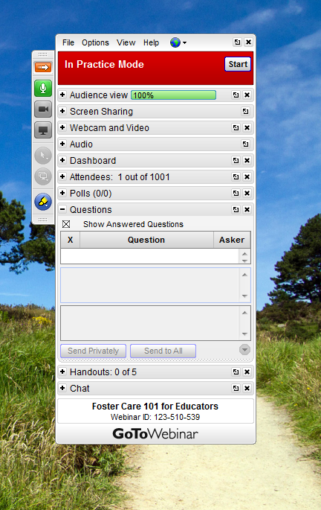
Questions?

Slide 6
Numbers Highlight Call to Action
Students in foster care experience educational instability and lag behind the general student population in high school completion.

Slide 7
Numbers Highlight Call to Action
Students in foster care are almost three times more likely to receive special education services compared to students in general population (24.5% compared to 8.8%).

Slide 8
Numbers Highlight Call to Action
Students in foster care are much more likely to be disciplined in school than other children; they receive out-of-school suspension at more than three times the rate of their peers (15.3% compared to 5.1%).

Slide 9
Numbers Highlight Call to Action
Children from the ages of 14-17 make up the largest percentage of children in the Texas child welfare system, totaling 23.1% of all youth in care.

Slide 10
Numbers Highlight Call to Action
1,410 young people aged out of foster care in 2011 and lived on average in eight different places.

Slide 11
Numbers Highlight Call to Action
Only 45% of the children in foster care live in their home county in May 2010.

Slide 12
Numbers Highlight Call to Action
The leaver status of students in foster care who left public school in grades 7-12 because they dropped out was significantly higher, with 28.7% of students in foster care leaving school as a dropout, compared to 8.4% of students statewide leaving school as a dropout.

Slide 13
Numbers Highlight Call to Action
The leaver status of students in foster care who left public schools in grades 7-12 because they graduated from high school was only 40.7%, while 70.7% of students statewide left school because they graduated.

Slide 14
Data
Alumni of Foster Care vs. National Sample
No high school diploma | 20% vs. 6%
2-year college degree | 4% vs. 10%
4-year college degree | 3% vs. 24%
One or more years of graduate school | 1% vs. 13%

Slide 15
PEIMS Coding
Documentation required for a school to report a student as a Foster Care student is as follows:
For Foster Care Indicator Code 0, no documentation is required because the student is not currently in the conservatorship of the Texas DFPS when enrolling in the school.
For Foster Care Indicator Code 1, the enrolling caregiver must provide a copy of the Texas DFPS Placement Authorization Form (Form 2085) or a court order that designates the student is in the conservatorship of the Department of Family and Protective Services.
For Foster Care Indicator Code 2, the Pre-kindergarten student is enrolling in school for the purpose of participating as an eligible student in a Pre-kindergarten program and eligibility documentation must be provided. At least annually, the Texas DFPS and Child Protective Services will mail verification letters of PK eligibility to the parents and caregivers of eligible children who in turn must provide this verification documentation to the school at enrollment.
Foster care status data should be handled with the utmost sensitivity and in accordance with all FERPA guidelines.
See PEIMS guidance from TEA

Slide 16
PEIMS Coding
Foster Care PEIMS Indicators— 102 Record—Column 30
0 | Student is not currently in the conservatorship of the TX DFPS
1 | Student is currently in the conservatorship of the TX DFPS
2 | Pre-kindergarten student was previously in the conservatorship of the TX DFPS

Slide 17
Scenario
Ben is attempting to enroll in school. The only paperwork the enrolling adult has with them is a form 2085 from CPS and proof of his residency. Can we enroll this student without the other records? If so, how should we code this student in PEIMS?

Slide 18
What about Informal Care?
Relative Care
Non-Relative Care
Emergency Shelter Care
Transitional Living
Unaccompanied Youth
---All Homeless and Not Foster Care

Slide 19
Document from THEO
Homelessness or Foster Care

Slide 20
Scenario
Jessica’s Uncle shows up at your campus to enroll her in school. He states that Jessica is involved with CPS and that he is currently the foster parent. He provides form 2298 and his proof of residency. How should this student be coded in PEIMS?

Slide 21
Different
Smells
Sounds
Food
Bedtime
Homework Help
Customs
Bed
Pillow
Soap
Temperature
Moral Expectations
Sense of Humor
Lighting

Slide 22
Same
Black Trash Bag
School Enrollment Hassles
Looks
Distrust
Confusion
Instability
Excuses

Slide 23
Cross-System Awareness

Slide 24
Partnerships

Slide 25
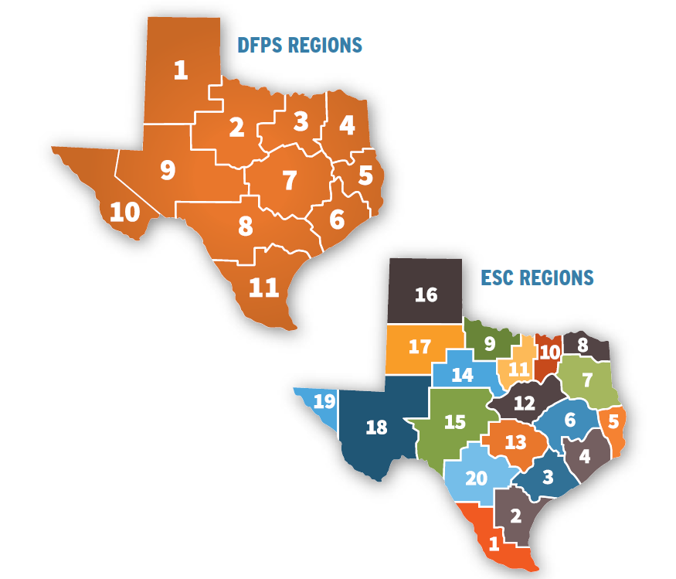
Partnerships

Slide 26
Foster Care Liaisons
Sec. 33.904. LIAISON FOR CERTAIN CHILDREN IN CONSERVATORSHIP OF STATE.
Each school district and open-enrollment charter school shall:
appoint at least one employee to act as a liaison officer to facilitate the enrollment in or transfer to a public school or open-enrollment charter school of a child in the district or area served by the charter school who is in the conservatorship of the state; and
(2) submit the liaison's name and contact information to the agency in a format and under the schedule determined by the commissioner.
(b) The agency shall provide information to the liaisons on practices for facilitating the enrollment in or transfer to a public school or open-enrollment charter school of children who are in the conservatorship of the state.

Slide 27
Foster Care Liaisons
 | Notify TEA of district Liaison (complete survey, join listserv) http://tea.texas.gov/FosterCareStudentSuccess/
 | Notify campus and district leaders of liaison appointment
 | Visit the TEA Foster Care & Student Success website and view webinar trainings
 | Develop and coordinate individual “Campus Champions” for students in foster care

Slide 28
Campus Champions
Campus Champion Report Card
Enrollment Procedures
Data Tracking
Access to Nutrition
Credit Recovery
Withdrawal
Transition Services
Coordination Outside School
School Assimilation

Slide 29
Enrollment
DO NOT DELAY-IMMEDIATELY ENROLL students in foster care!!!
Maintain confidentiality and sensitivity in the front office when enrolling a student
Have records been requested?
Does the student need special education services?
Is the student placed in appropriate classes?
Does the student need materials?

Slide 30
Identity of Legal Authority
Who can Enroll?
Foster Parent
CPS caseworker or other staff
CASA or student’s guardian ad litem
Residential facility staff
Child Placing Agency staff, including case manager, or
Biological parent, in some cases.
The person enrolling the student should have either a DFPS Placement Authorization Form 2085 or a court order naming DFPS as Temporary Managing Conservator

Slide 31
Proof of Residence
A parent or caregiver must provide appropriate documentation of residency in the school district.
Utility bill receipts
Lease information
Other documents allowed by one’s local school and district that confirm residence

Slide 32
Proof of child’s identity
2085
Driver’s license
Passport
School ID card, records, or report card
Military ID
Hospital birth records
Adoption records
Church baptismal record

Slide 33
Immunization Records
A person may be provisionally admitted to an elementary or secondary school if the person has begun the required immunizations and if the person continues to receive the necessary immunizations as rapidly as is medically feasible.
The CPS caseworker must:
Ensure that the child visits the doctor/health clinic to begin immunizations
Notify the school that immunizations have begun; and
Make sure that immunizations are completed and that the immunization records are submitted to the school
30-day Provisional Enrollment for students who are homeless or Foster Care

Slide 34
School Records
Upon enrollment, the district should make a bona fide effort to secure all records from the previous district
If the student is age 11 and under, Texas law requires that the person enrolling the child provide to the new school the name of each previous school attended by the child

Slide 35
DFPS Education Specialists
TXDFPS Region 03
Norma Eaves – 817.792.5269
Beverly Nelson – 817.792.5273

Slide 36
Support at School
School Wide Programs Include:
Positive Behavior Interventions and Supports
Trauma Informed Care
Resiliency Training
Restorative Justice/ Restorative Discipline

Slide 37
Support at School
Maintain Confidentiality
Prepare for missed school
Build Relationships
Allow for decision making
Review 25.007 for Transition Ideas

Slide 38
At-Risk Elligibility
Nutrition
Tutoring
Supplemental Reading or Math Programs
School Social Services
Community Resources and Mentors
Direct, Group or Crisis Counseling

Slide 39
Into Adulthood
Insurance
STAR Health (a Medicaid program)
Update addresses
Driver’s License
Waived driver’s license fees
Other Documents
Birth certificate
Social security card
Immunization records
Insurance records

Slide 40
Post-Secondary Education
Tuition and Fee Waiver
Education and Training Voucher (ETV)
Free Application for Federal Student Aid (FAFSA)

Slide 41
Transportation
Addressed in ESSA: Review Guidance

Slide 42
Questions?
?

